Slide 1



Weather_Analysis
View in Power BI
Last data refresh:
5/19/2025 6:33:38 PM UTC
Downloaded at:
5/19/2025 7:40:19 PM UTC

Slide 2
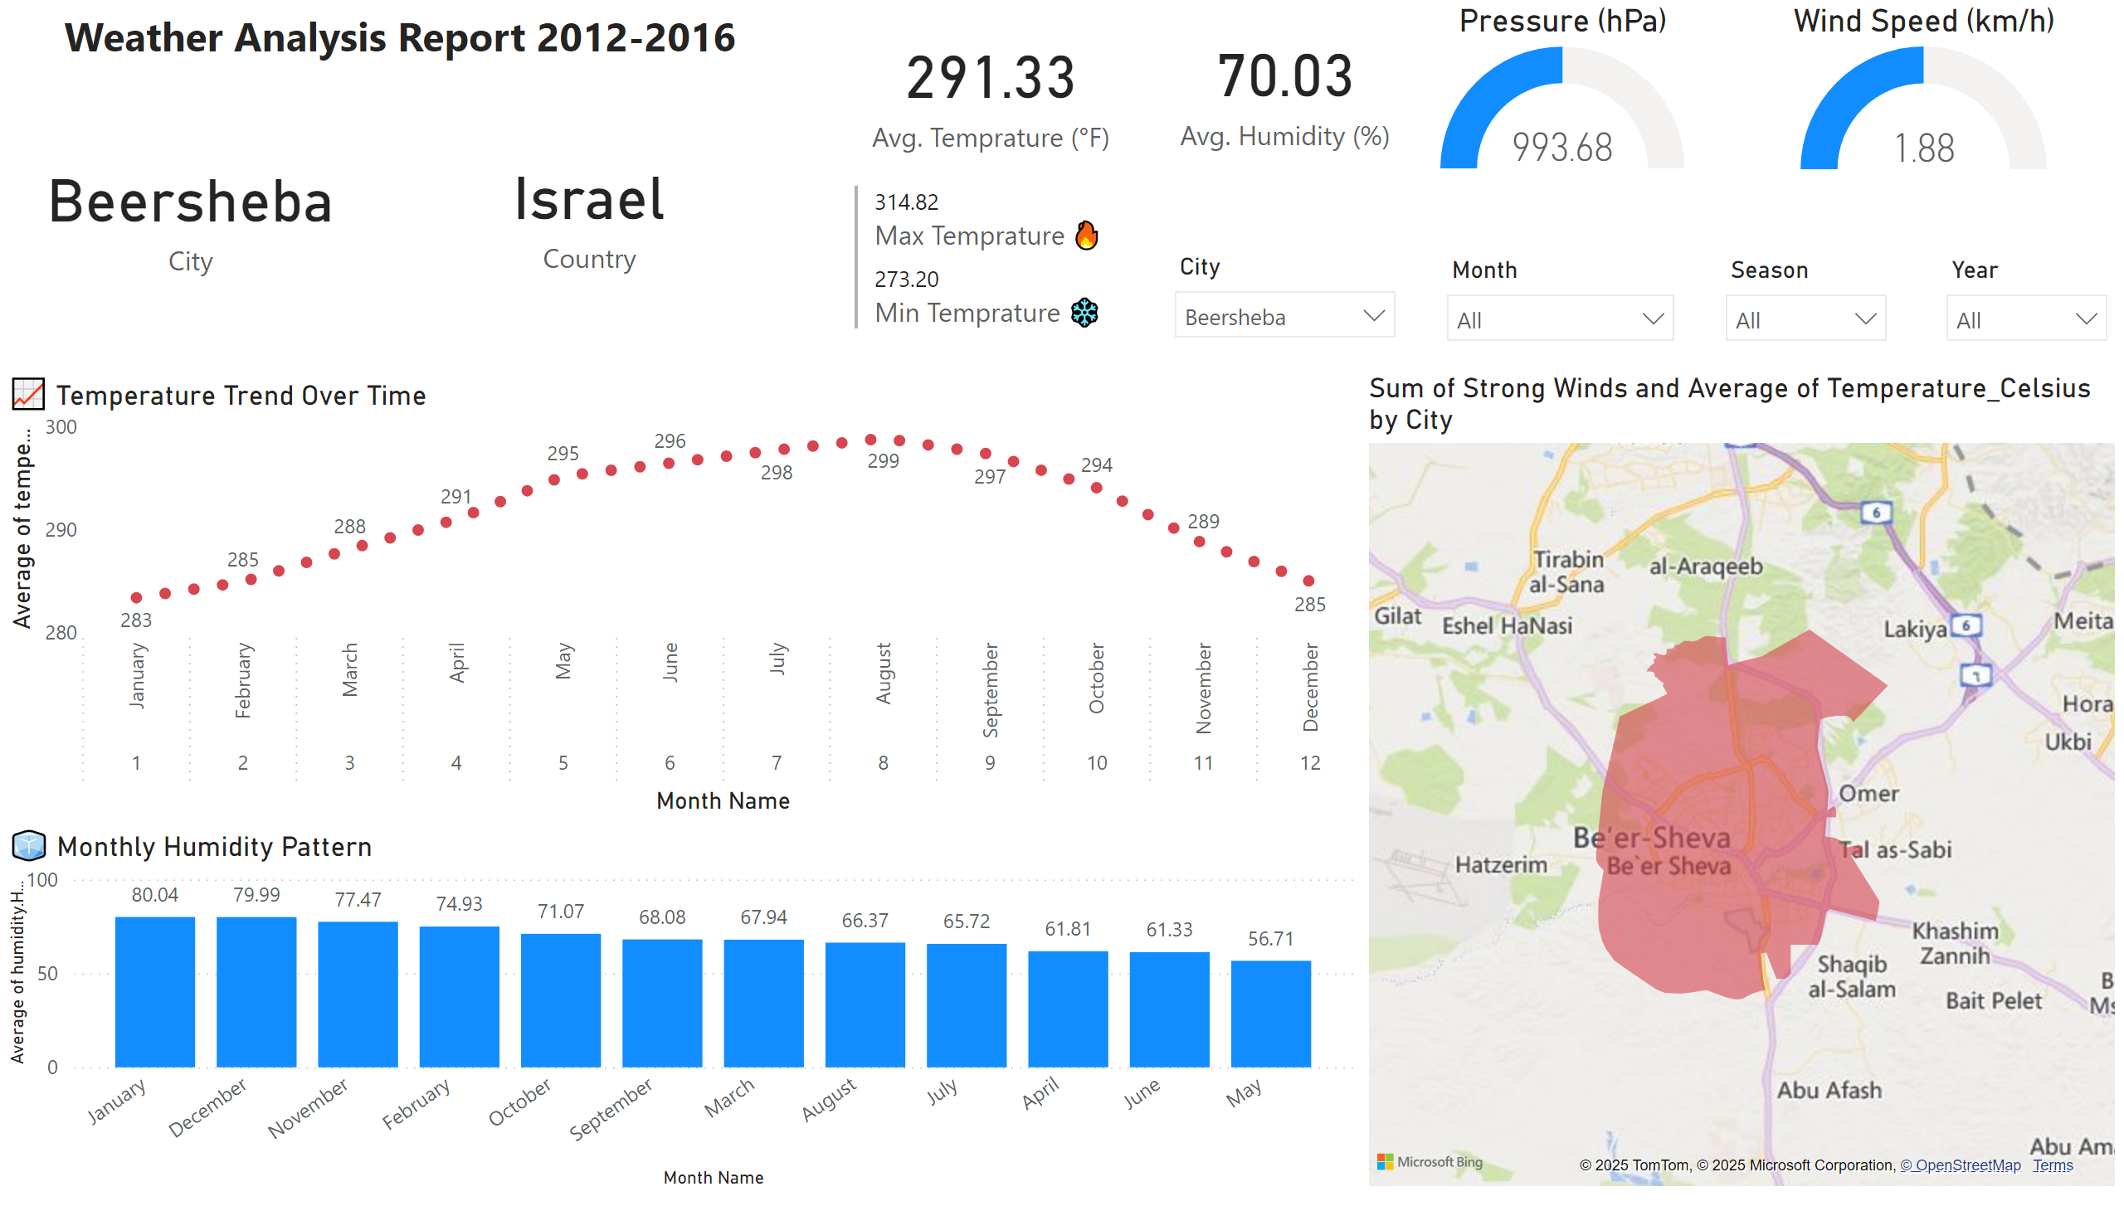
Dashboard_1
Notes:
card
No alt text provided
card
No alt text provided
card
No alt text provided
multiRowCard
No alt text provided
slicer
No alt text provided
slicer
No alt text provided
slicer
No alt text provided
card
No alt text provided
textbox
No alt text provided
slicer
No alt text provided
📈 Temperature Trend Over Time
No alt text provided
🧊 Monthly Humidity Pattern
No alt text provided
filledMap
No alt text provided
Pressure (hPa)
No alt text provided
Wind Speed (km/h)
No alt text provided

Slide 3
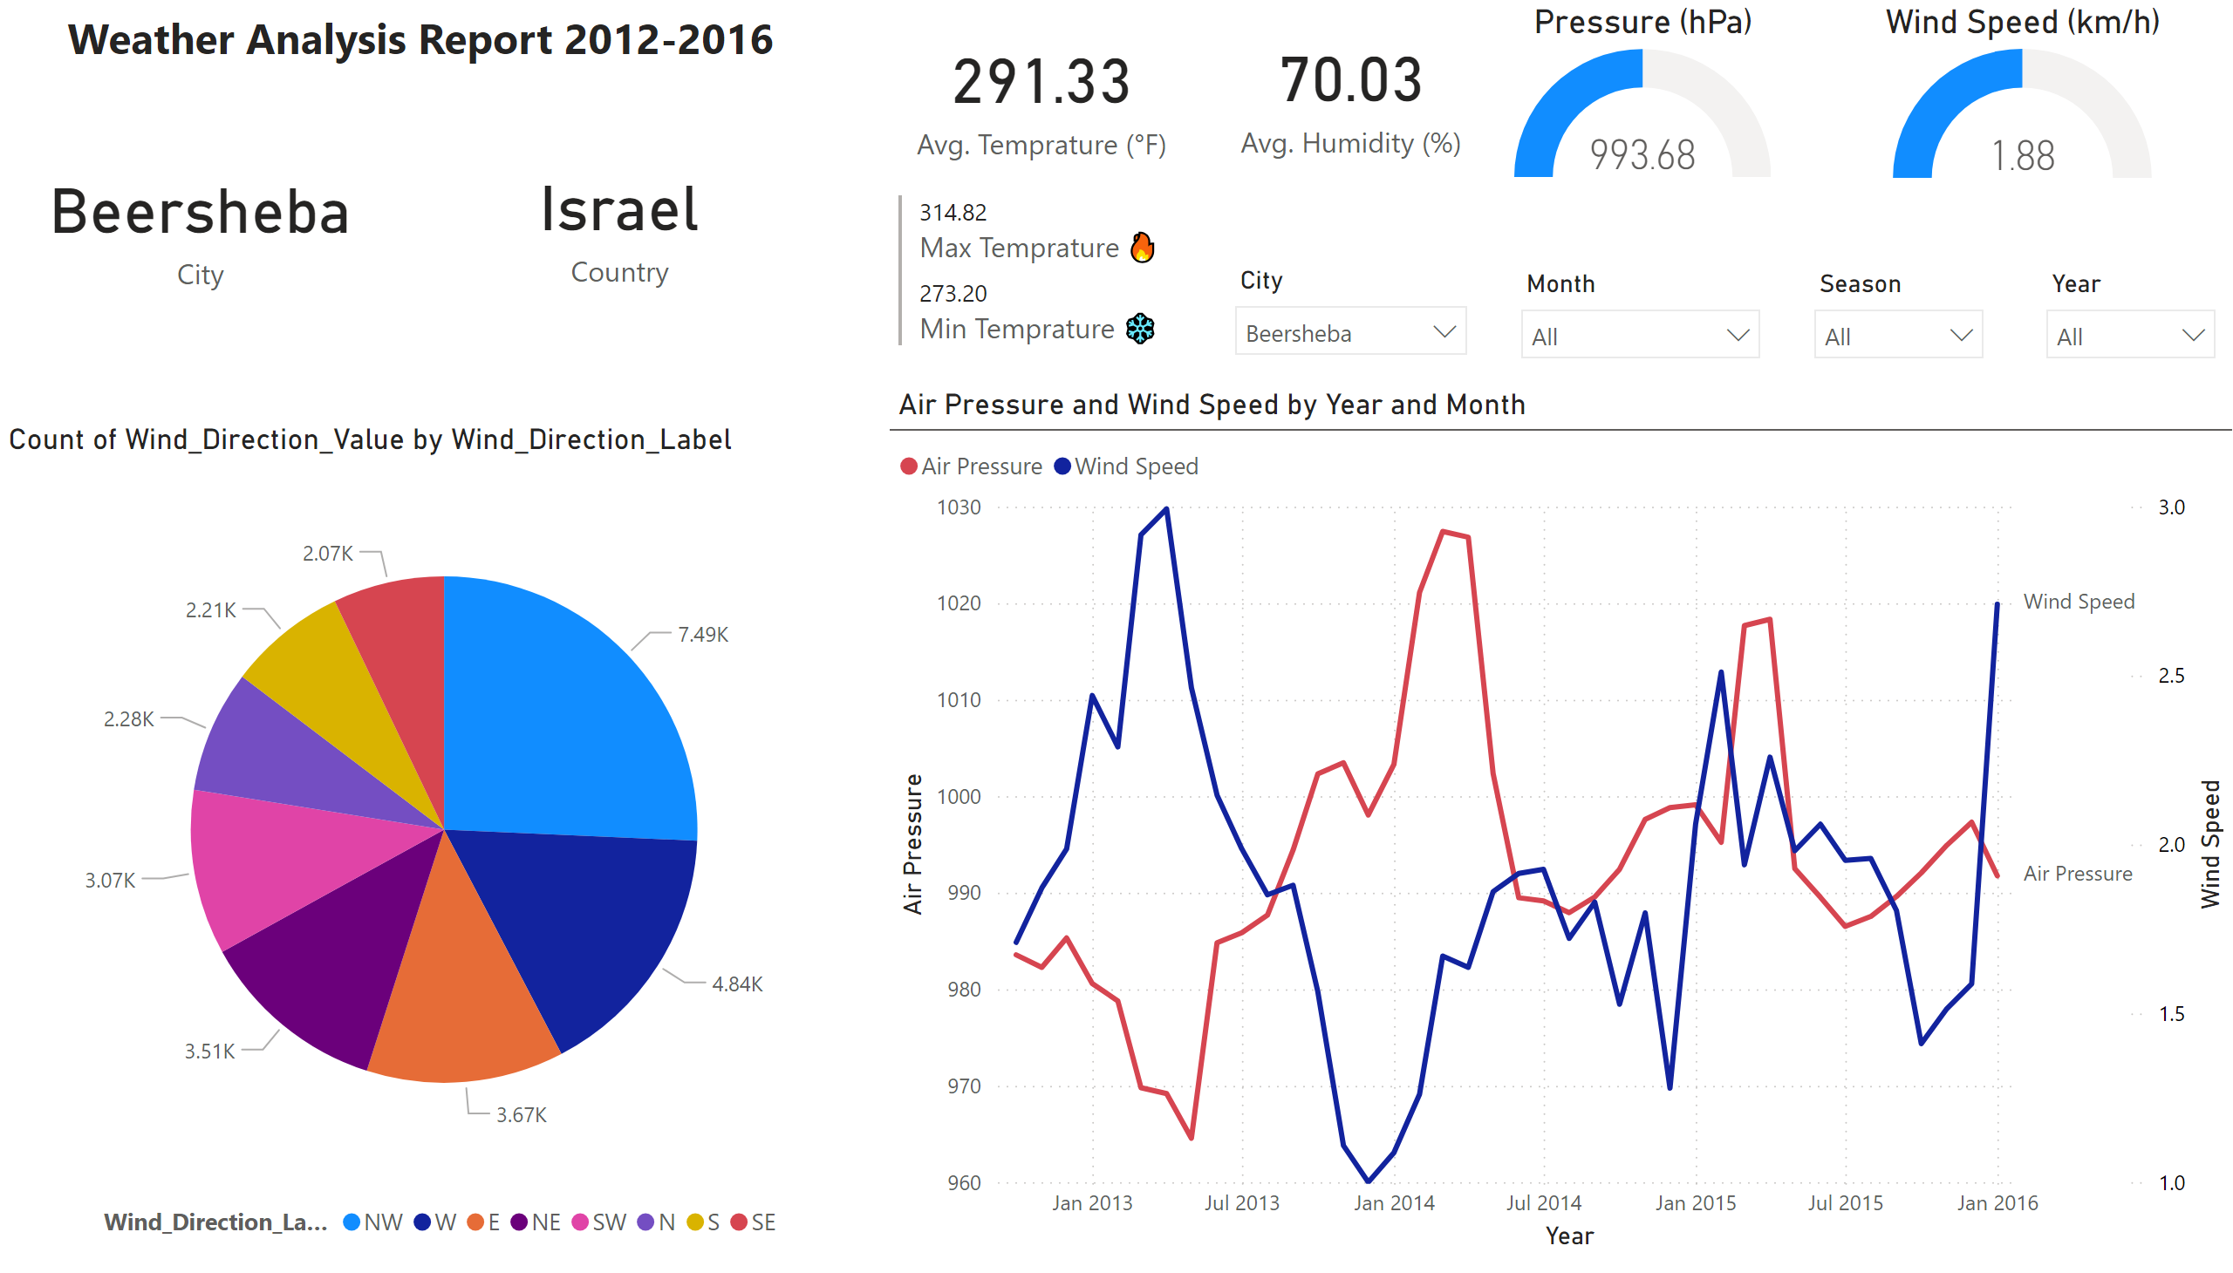
Dashboard_2
Notes:
card
No alt text provided
card
No alt text provided
card
No alt text provided
multiRowCard
No alt text provided
slicer
No alt text provided
slicer
No alt text provided
slicer
No alt text provided
card
No alt text provided
textbox
No alt text provided
slicer
No alt text provided
pieChart
No alt text provided
lineChart
No alt text provided
Pressure (hPa)
No alt text provided
Wind Speed (km/h)
No alt text provided

Slide 4
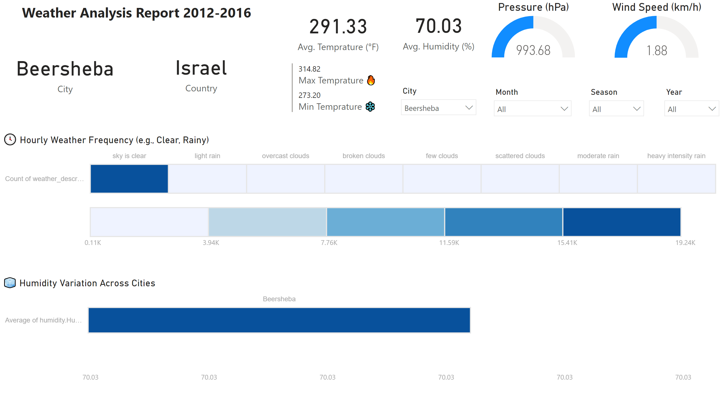
Dashboard_3
Notes:
🧊 Humidity Variation Across Cities
No alt text provided
🕓 Hourly Weather Frequency (e.g., Clear, Rainy)
No alt text provided
textbox
No alt text provided
card
No alt text provided
card
No alt text provided
slicer
No alt text provided
slicer
No alt text provided
slicer
No alt text provided
slicer
No alt text provided
multiRowCard
No alt text provided
card
No alt text provided
card
No alt text provided
Pressure (hPa)
No alt text provided
Wind Speed (km/h)
No alt text provided

Slide 5
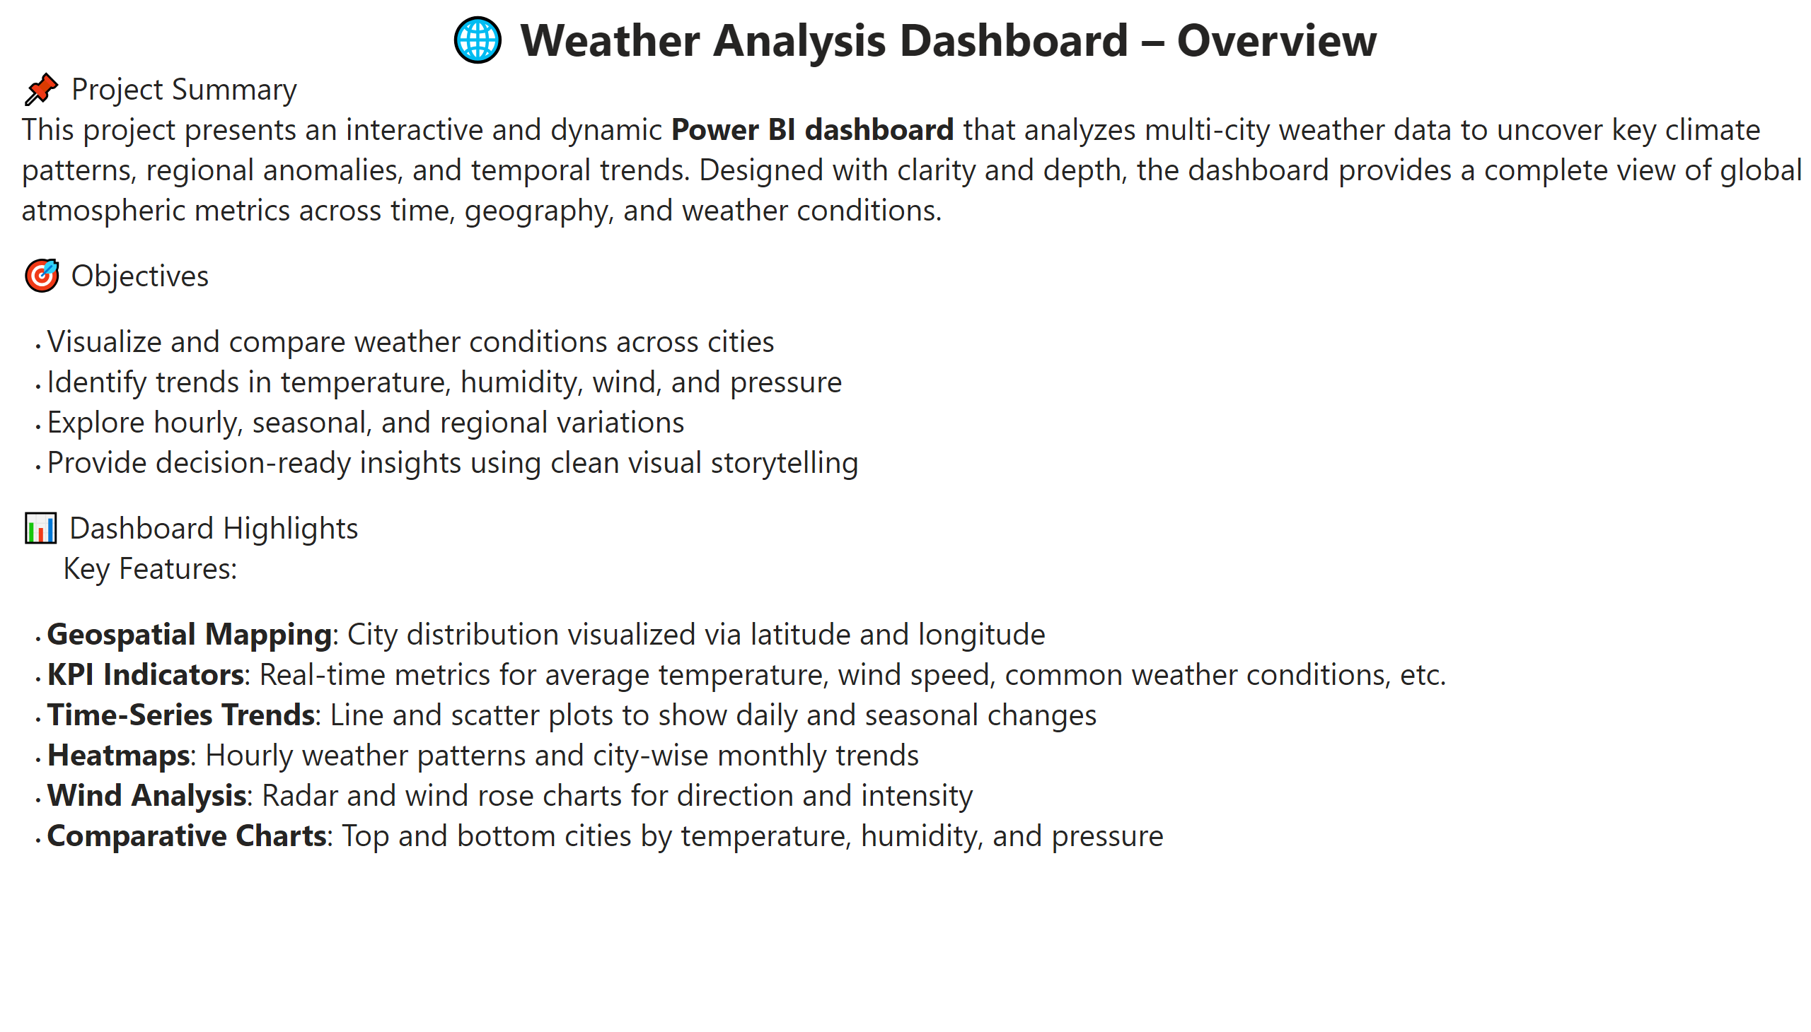
Overview Page
Notes:
textbox
No alt text provided

Slide 6
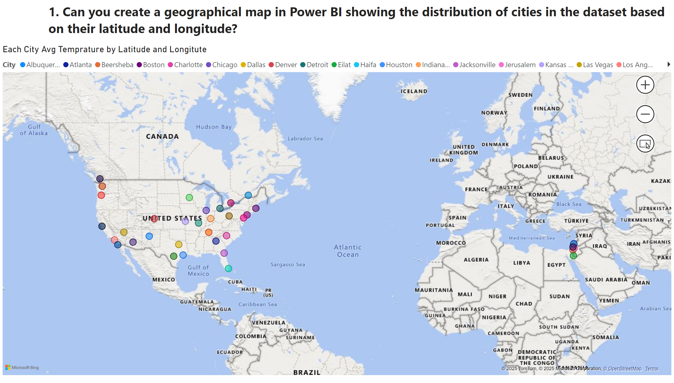
Q1
Notes:
Each City Avg Temprature by Latitude and Longitute
No alt text provided
textbox
No alt text provided

Slide 7
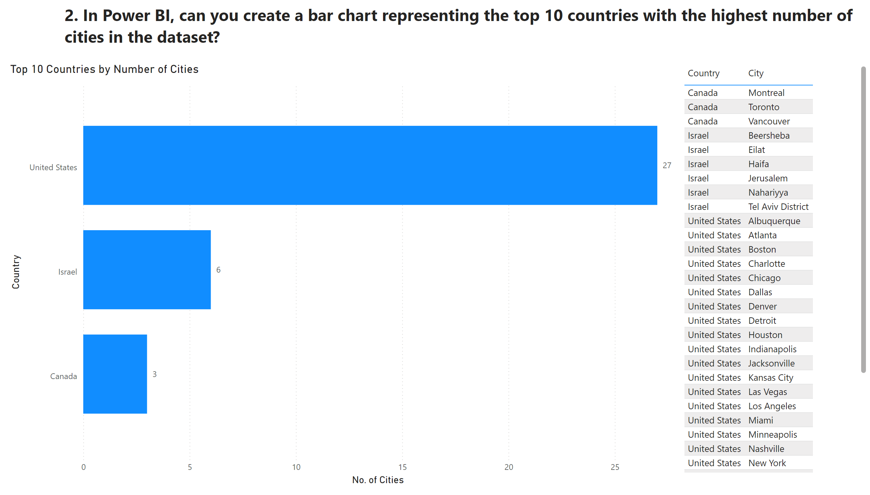
Q2
Notes:
Top 10 Countries by Number of Cities
No alt text provided
tableEx
No alt text provided
textbox
No alt text provided

Slide 8
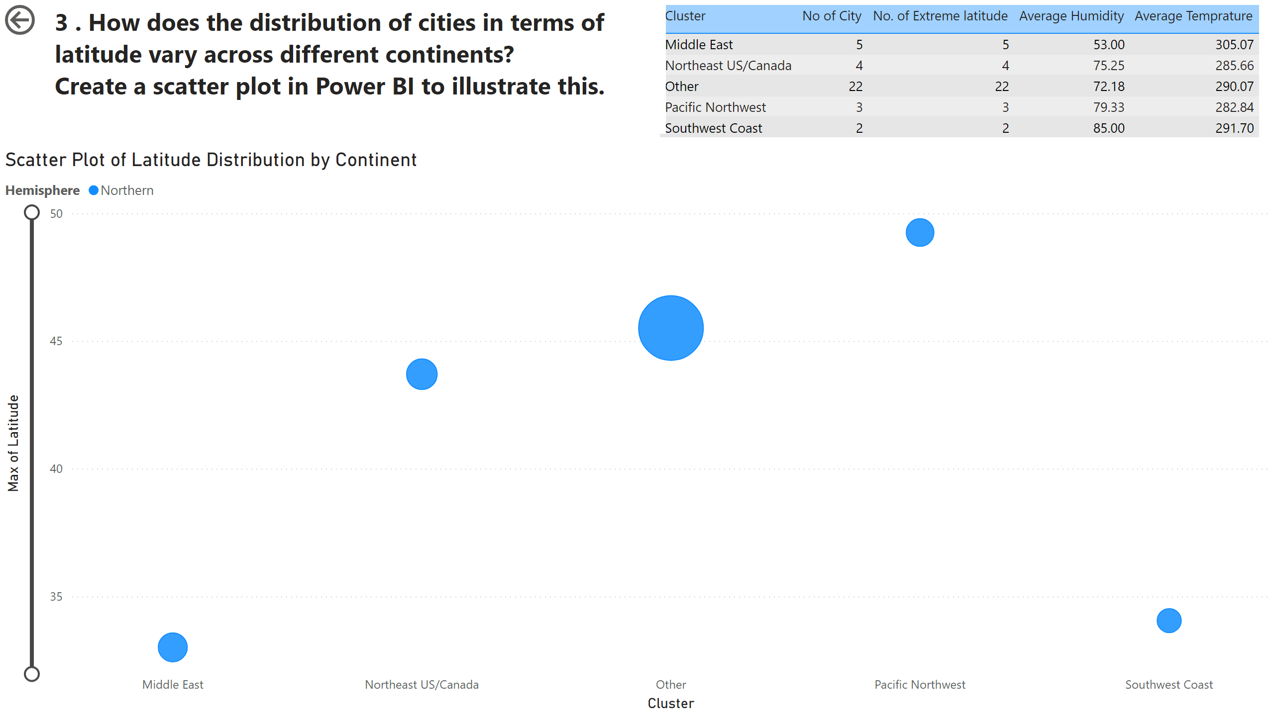
Q3
Notes:
Scatter Plot of Latitude Distribution by Continent
No alt text provided
actionButton
No alt text provided
tableEx
No alt text provided
textbox
No alt text provided

Slide 9
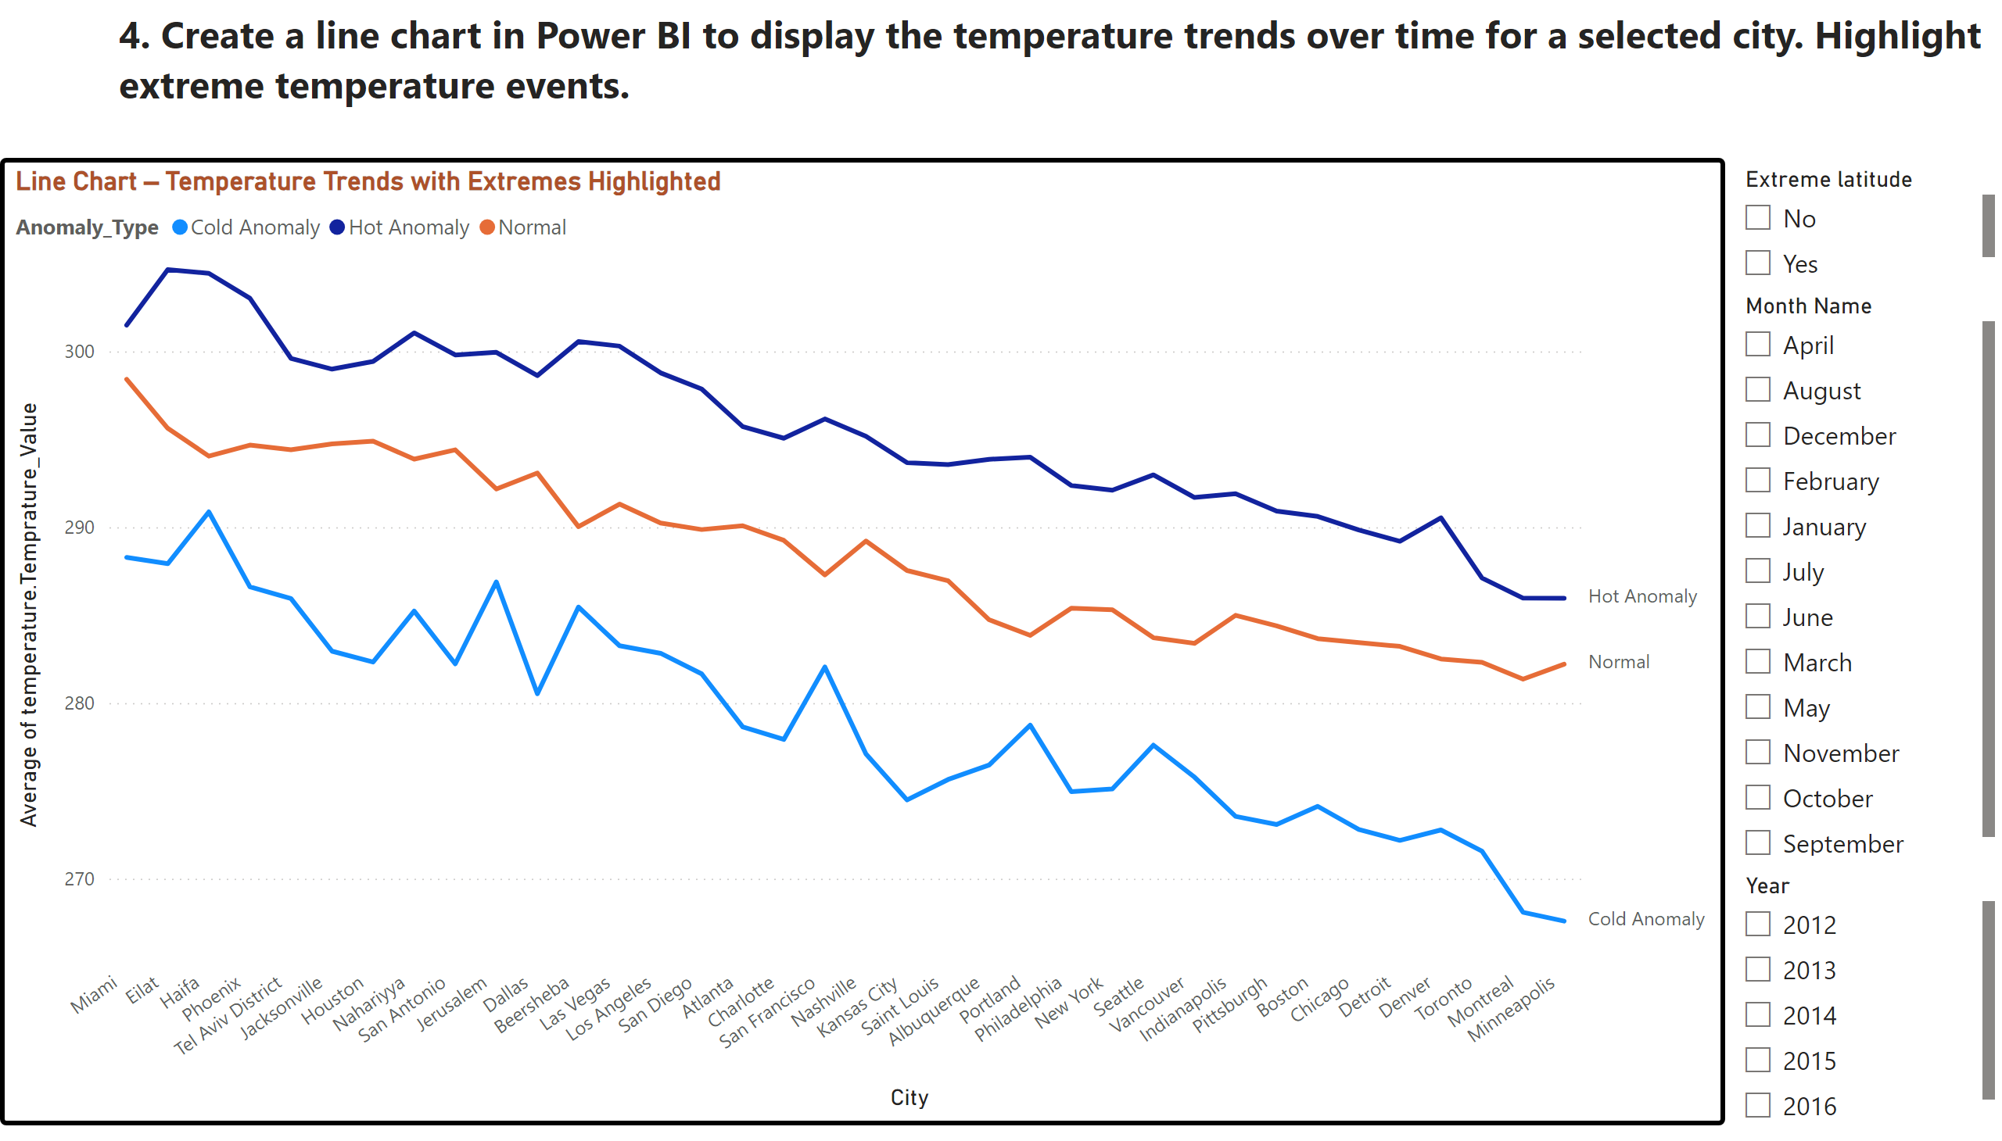
Q4
Notes:
Line Chart – Temperature Trends with Extremes Highlighted
No alt text provided
slicer
No alt text provided
slicer
No alt text provided
slicer
No alt text provided
textbox
No alt text provided

Slide 10
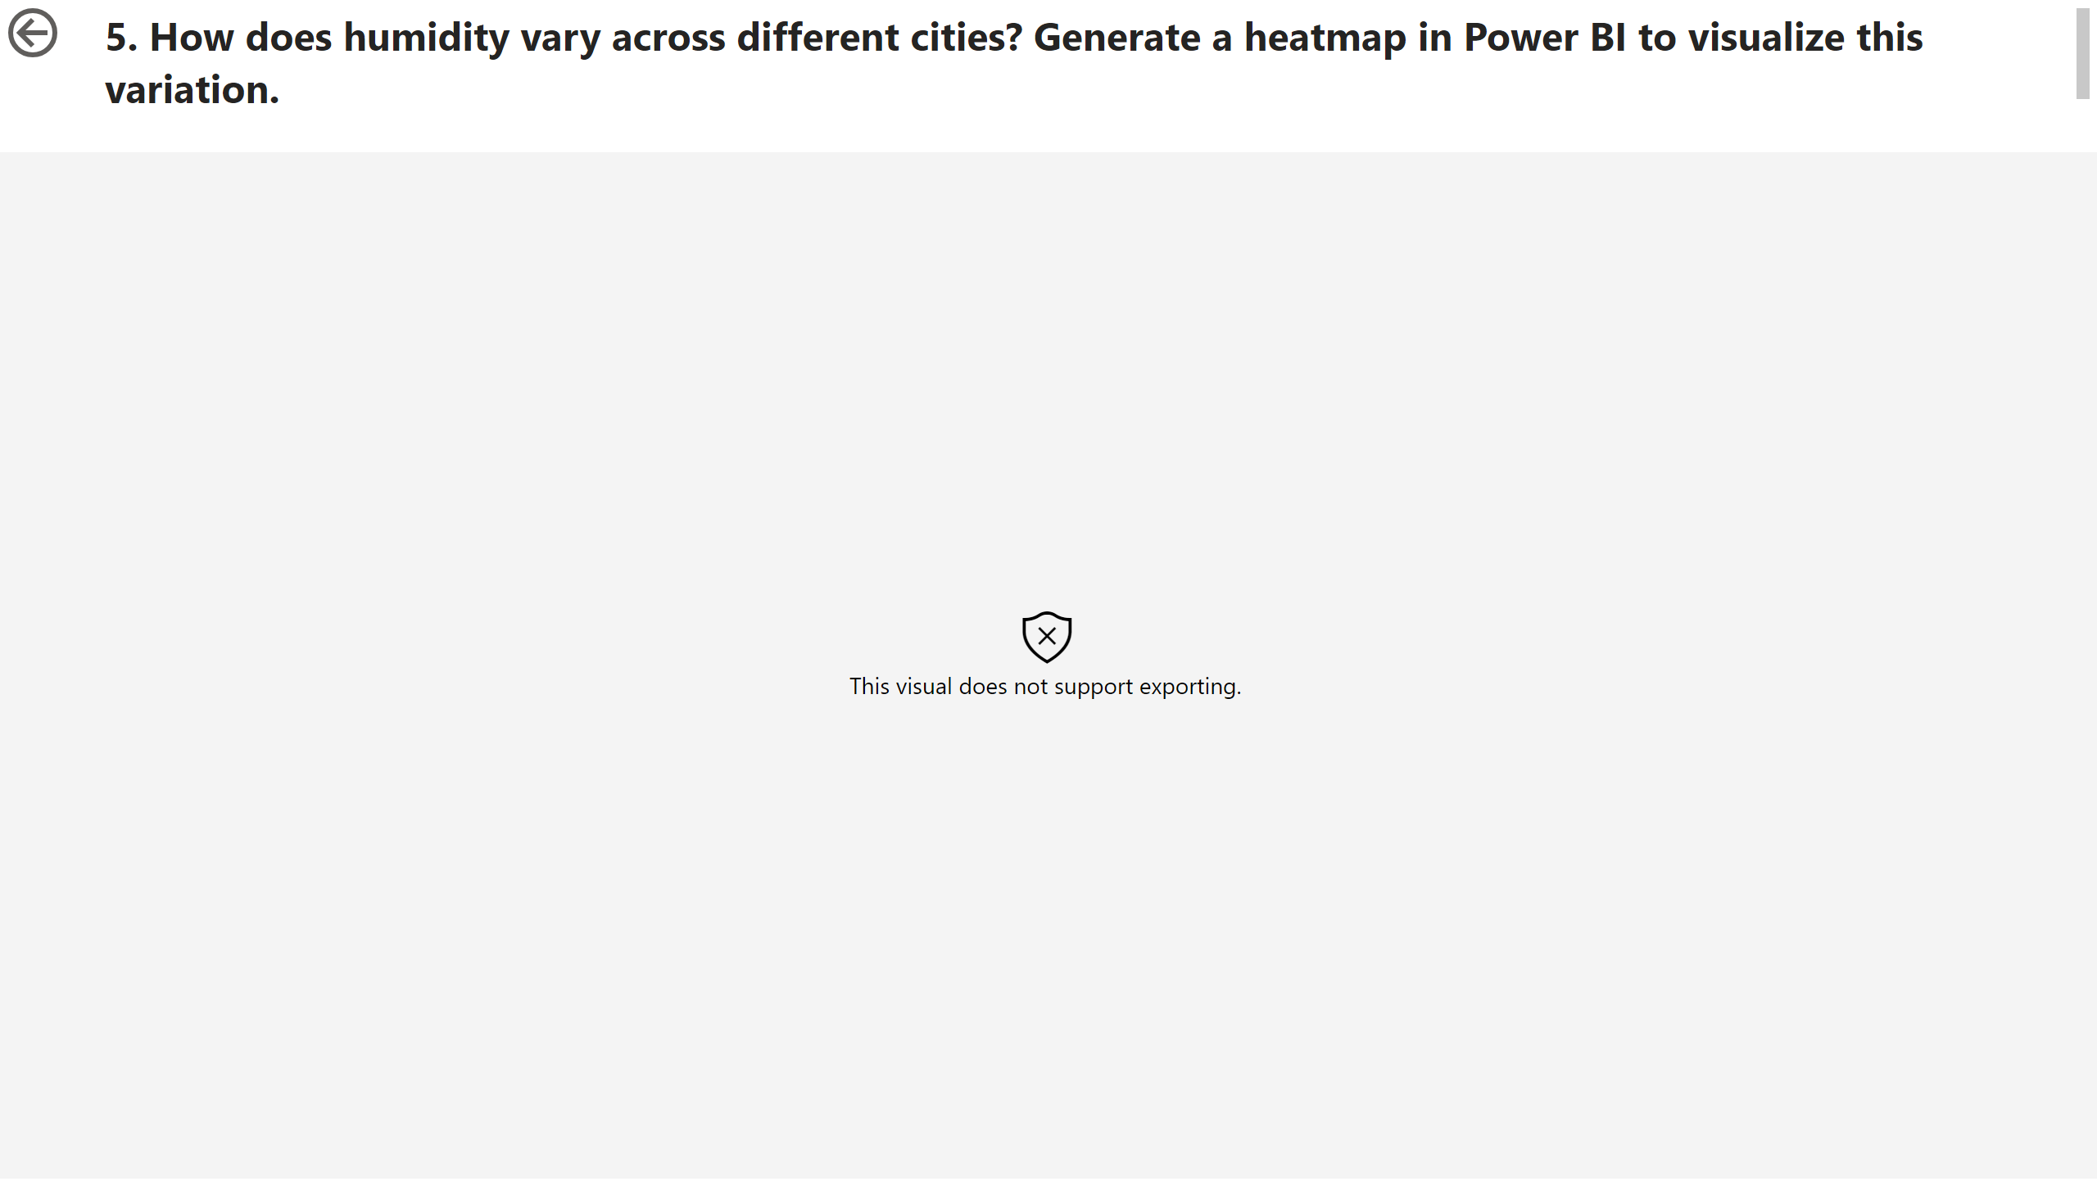
Q5
Notes:
textbox
No alt text provided
Heatmap – Humidity Variation Across Cities
No alt text provided
actionButton
No alt text provided

Slide 11
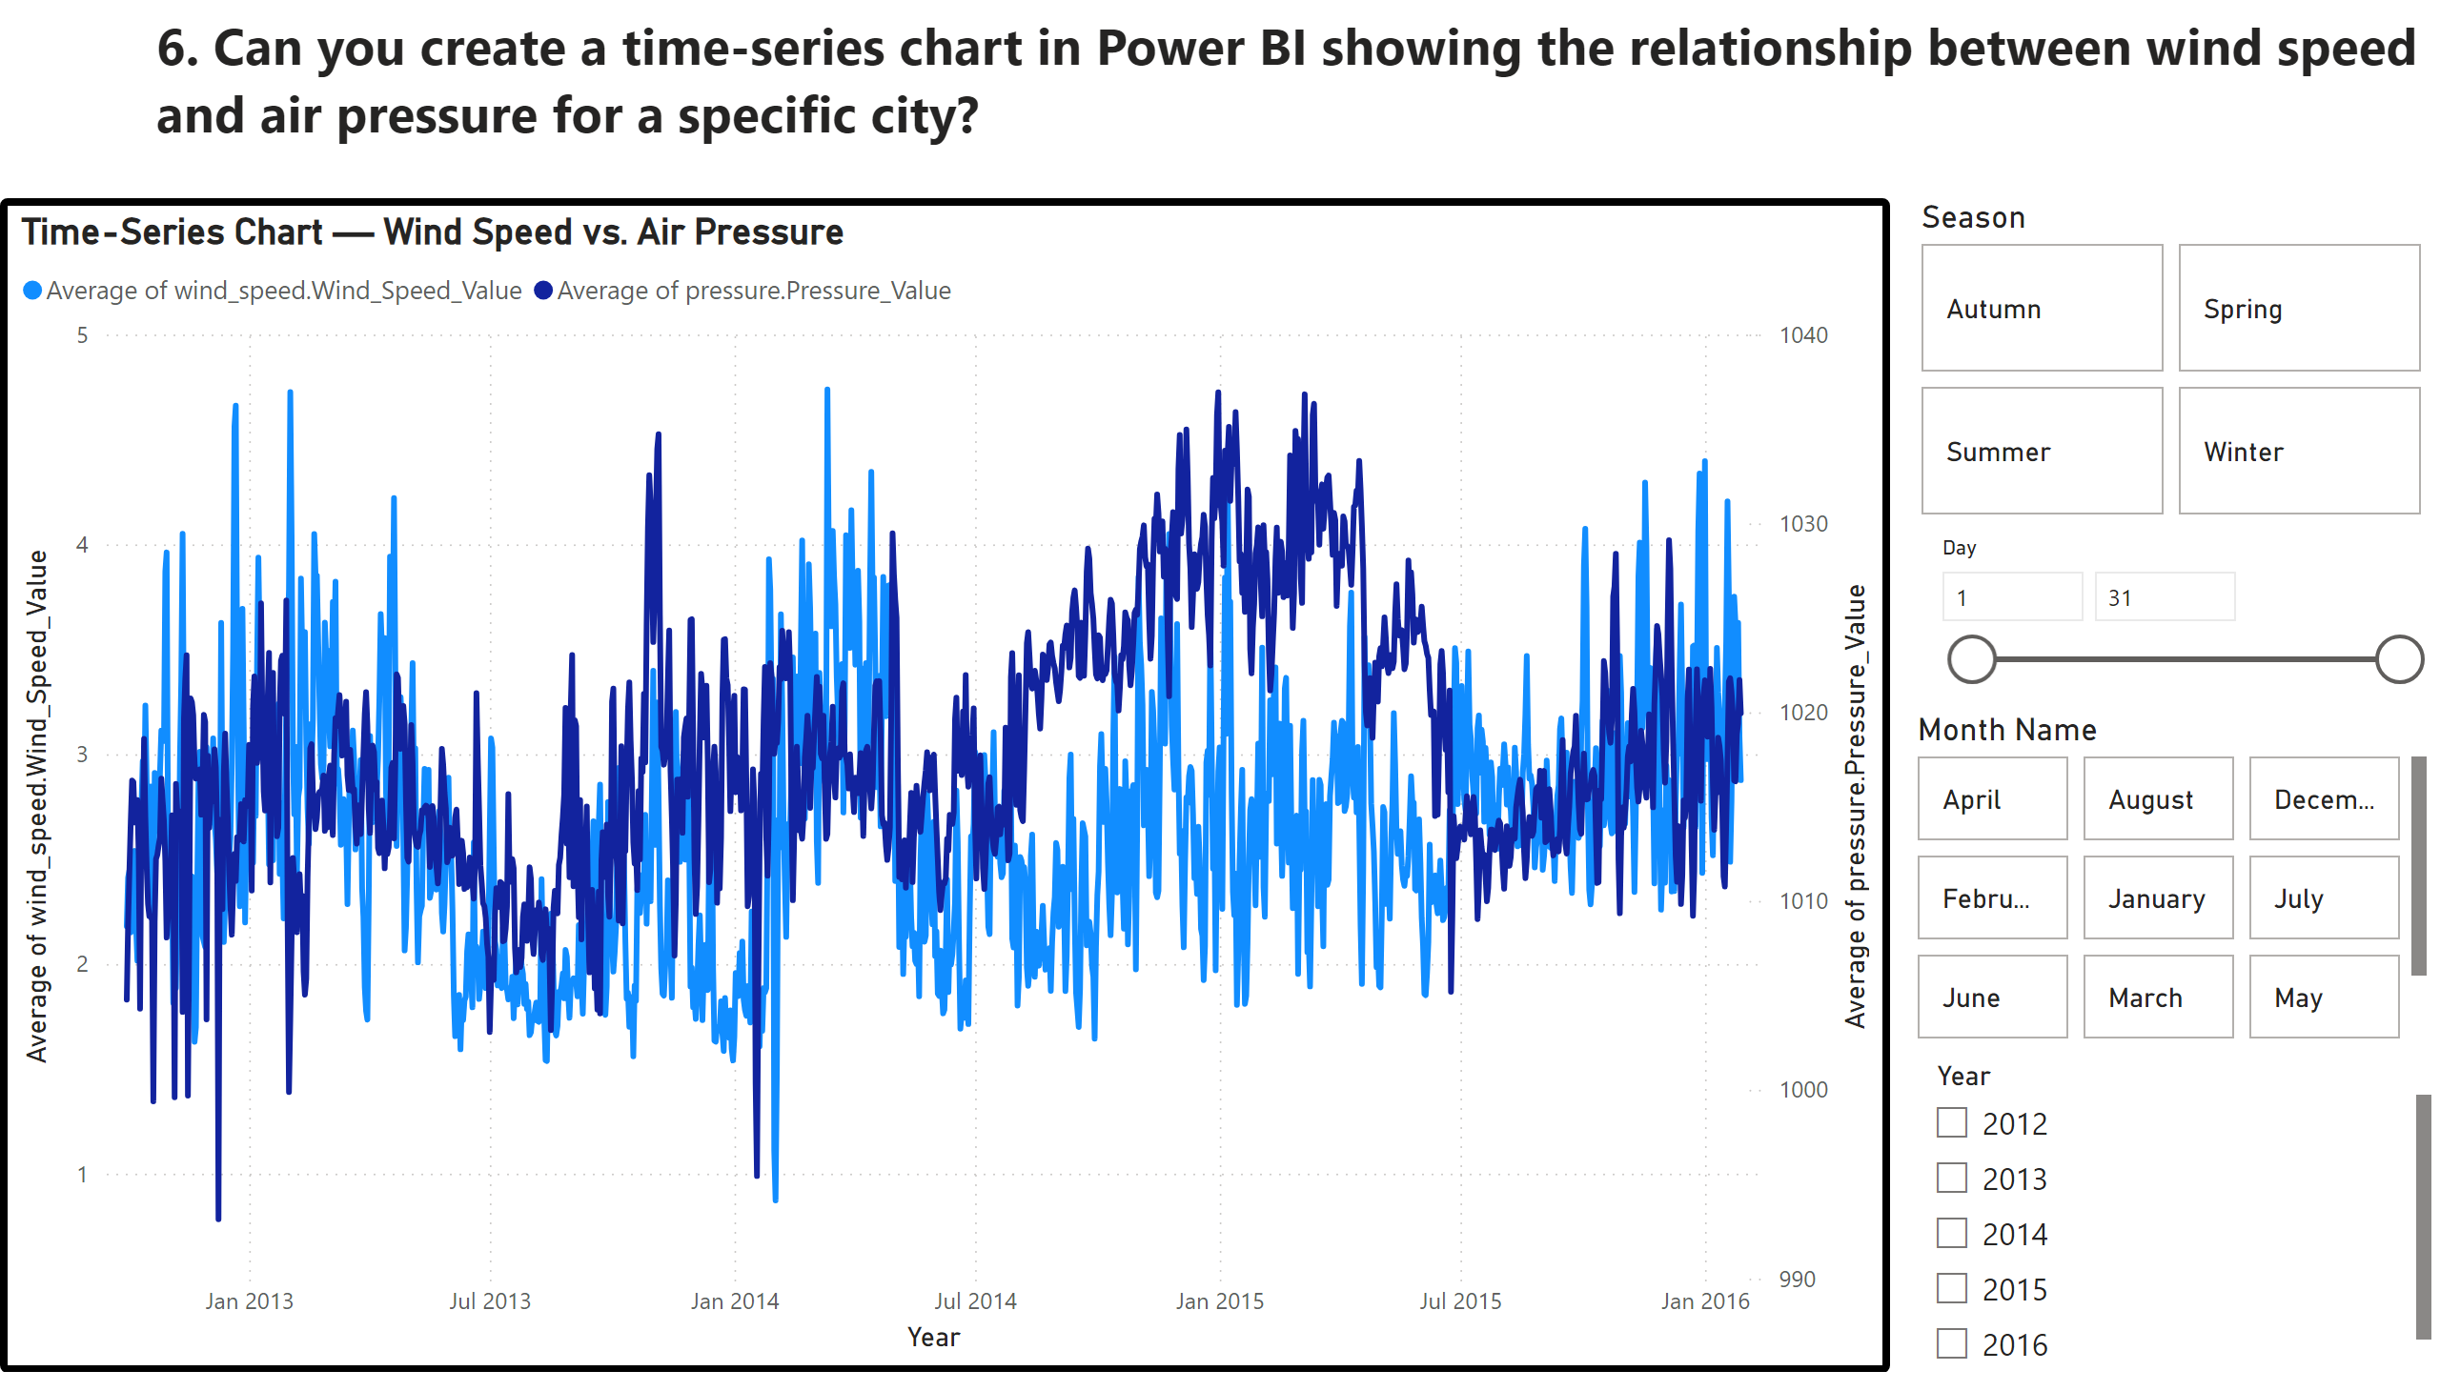
Q6
Notes:
Time-Series Chart — Wind Speed vs. Air Pressure
No alt text provided
slicer
No alt text provided
advancedSlicerVisual
No alt text provided
advancedSlicerVisual
No alt text provided
textbox
No alt text provided
slicer
No alt text provided

Slide 12
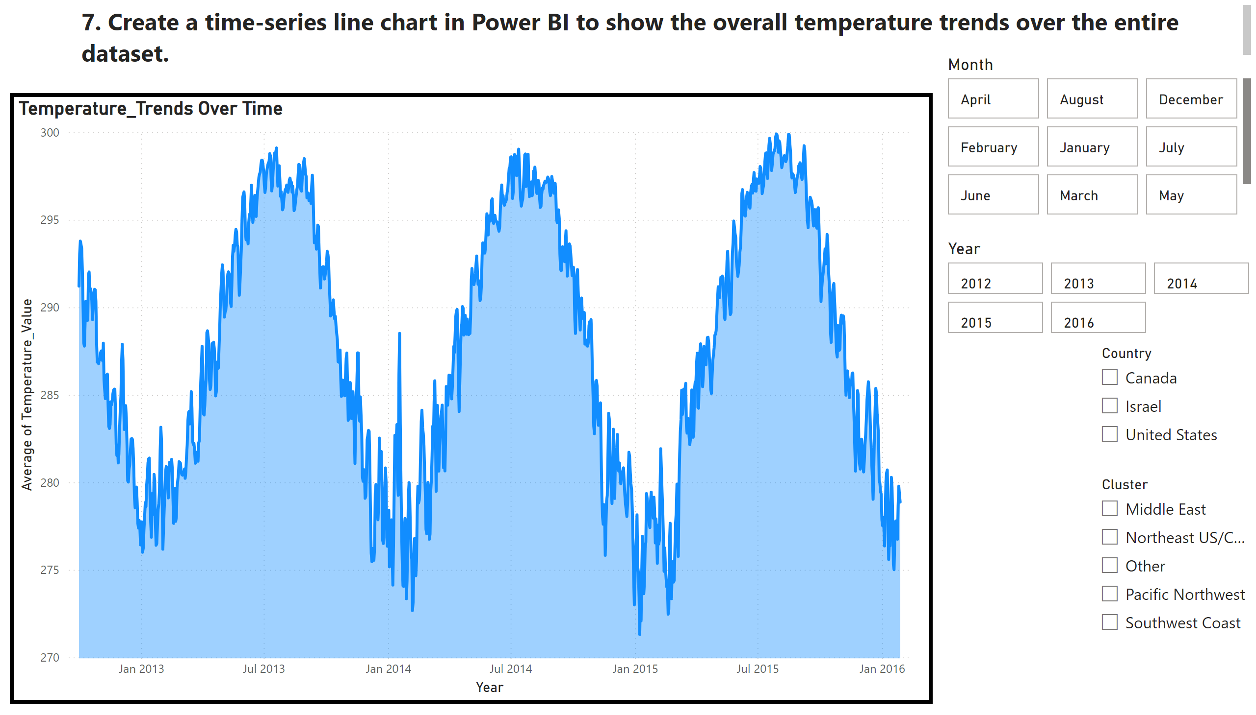
Q7
Notes:
textbox
No alt text provided
Temperature_Trends Over Time
No alt text provided
slicer
No alt text provided
advancedSlicerVisual
No alt text provided
advancedSlicerVisual
No alt text provided
slicer
No alt text provided
slicer
No alt text provided

Slide 13
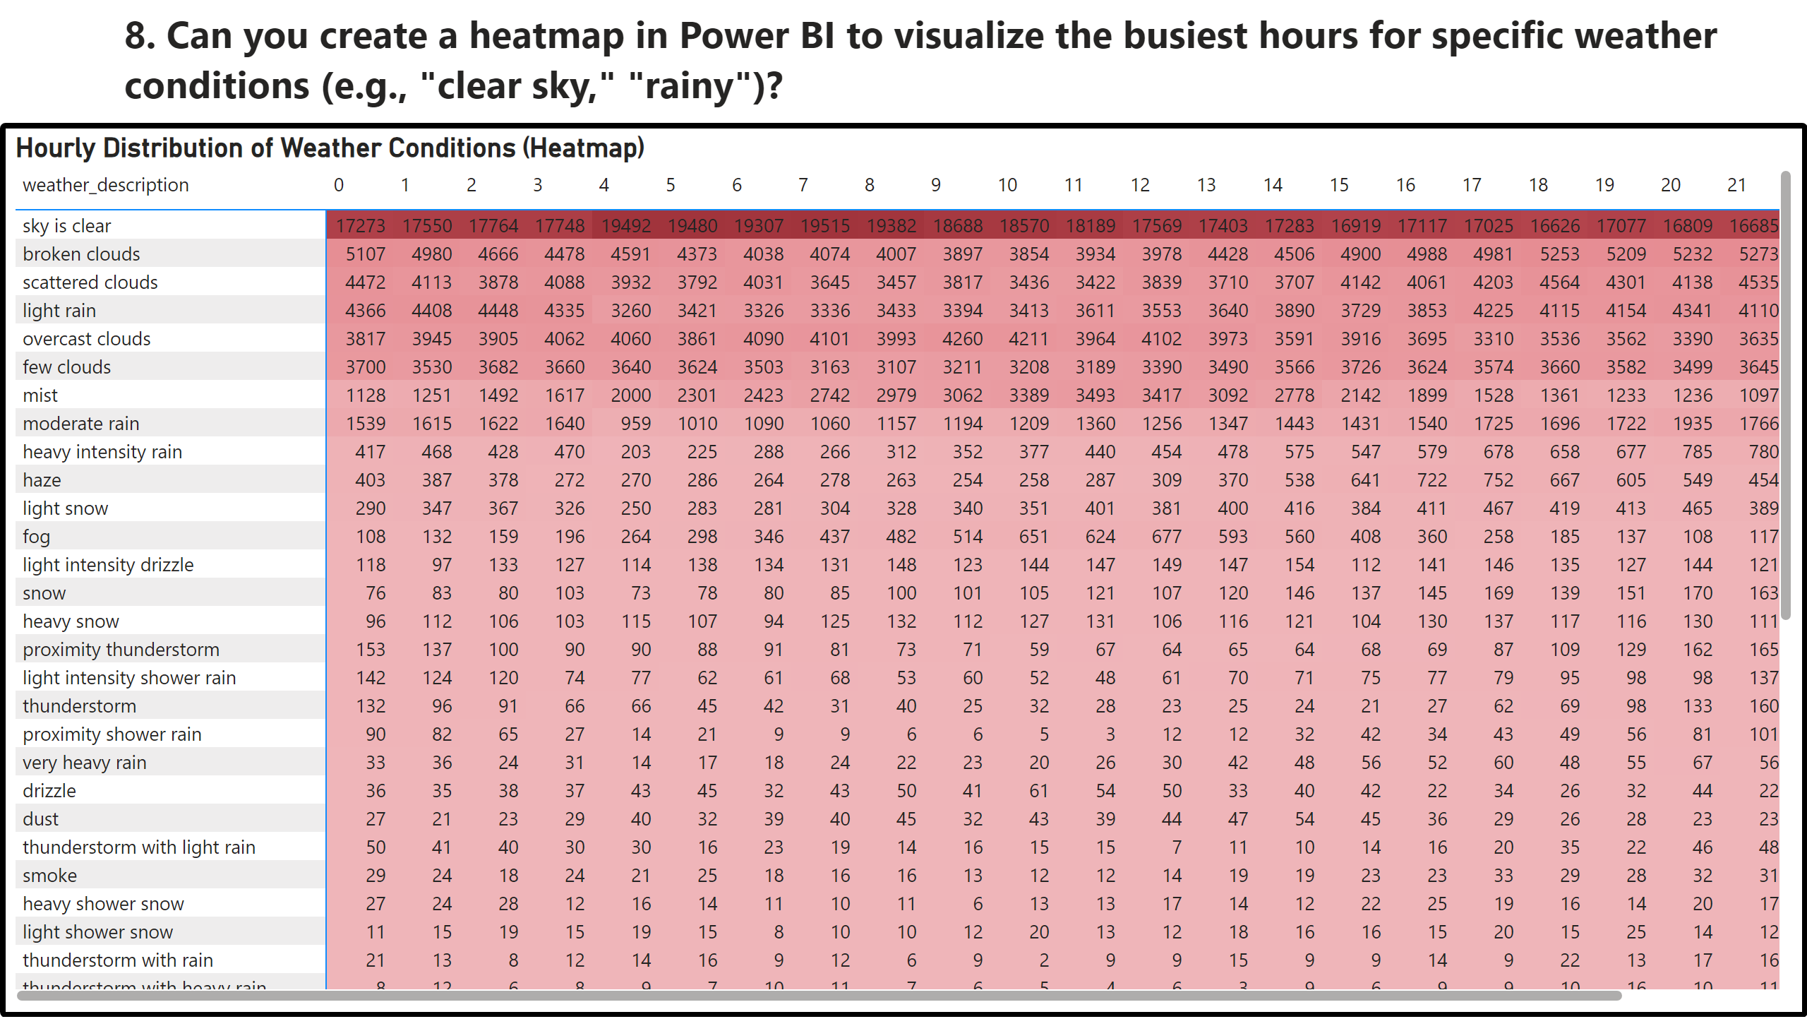
Q8
Notes:
textbox
No alt text provided
Hourly Distribution of Weather Conditions (Heatmap)
No alt text provided

Slide 14
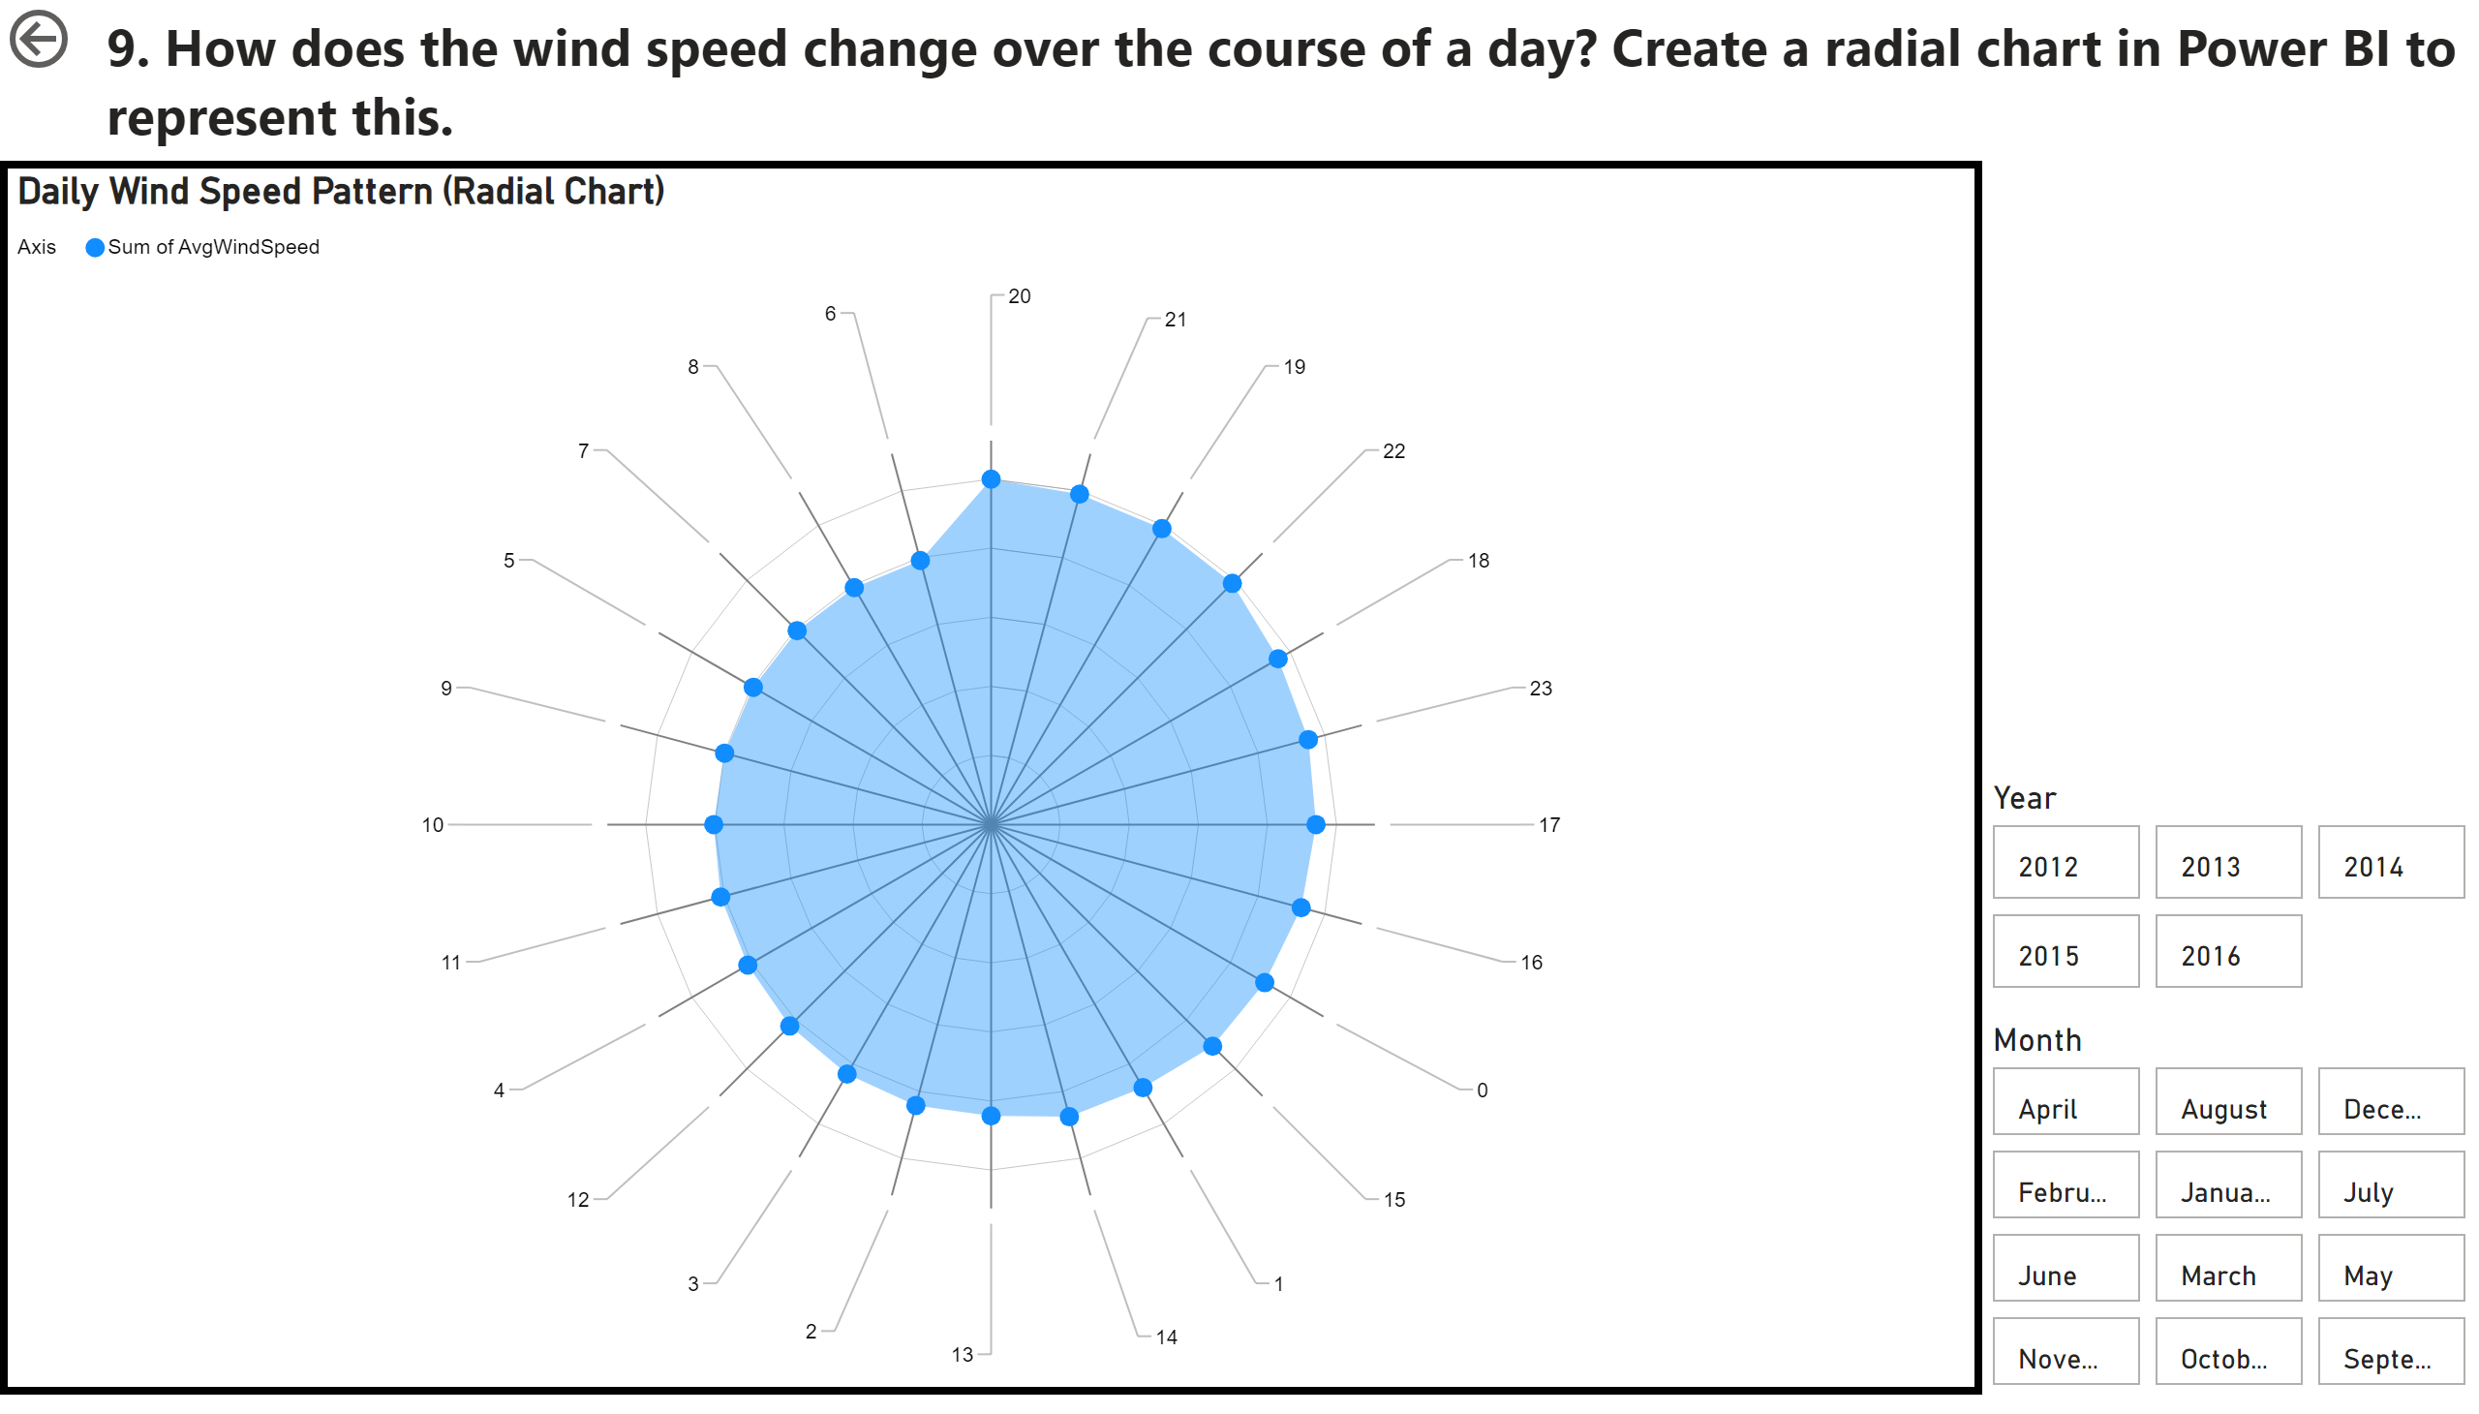
Q9
Notes:
textbox
No alt text provided
Daily Wind Speed Pattern (Radial Chart)
No alt text provided
actionButton
No alt text provided
advancedSlicerVisual
No alt text provided
advancedSlicerVisual
No alt text provided

Slide 15
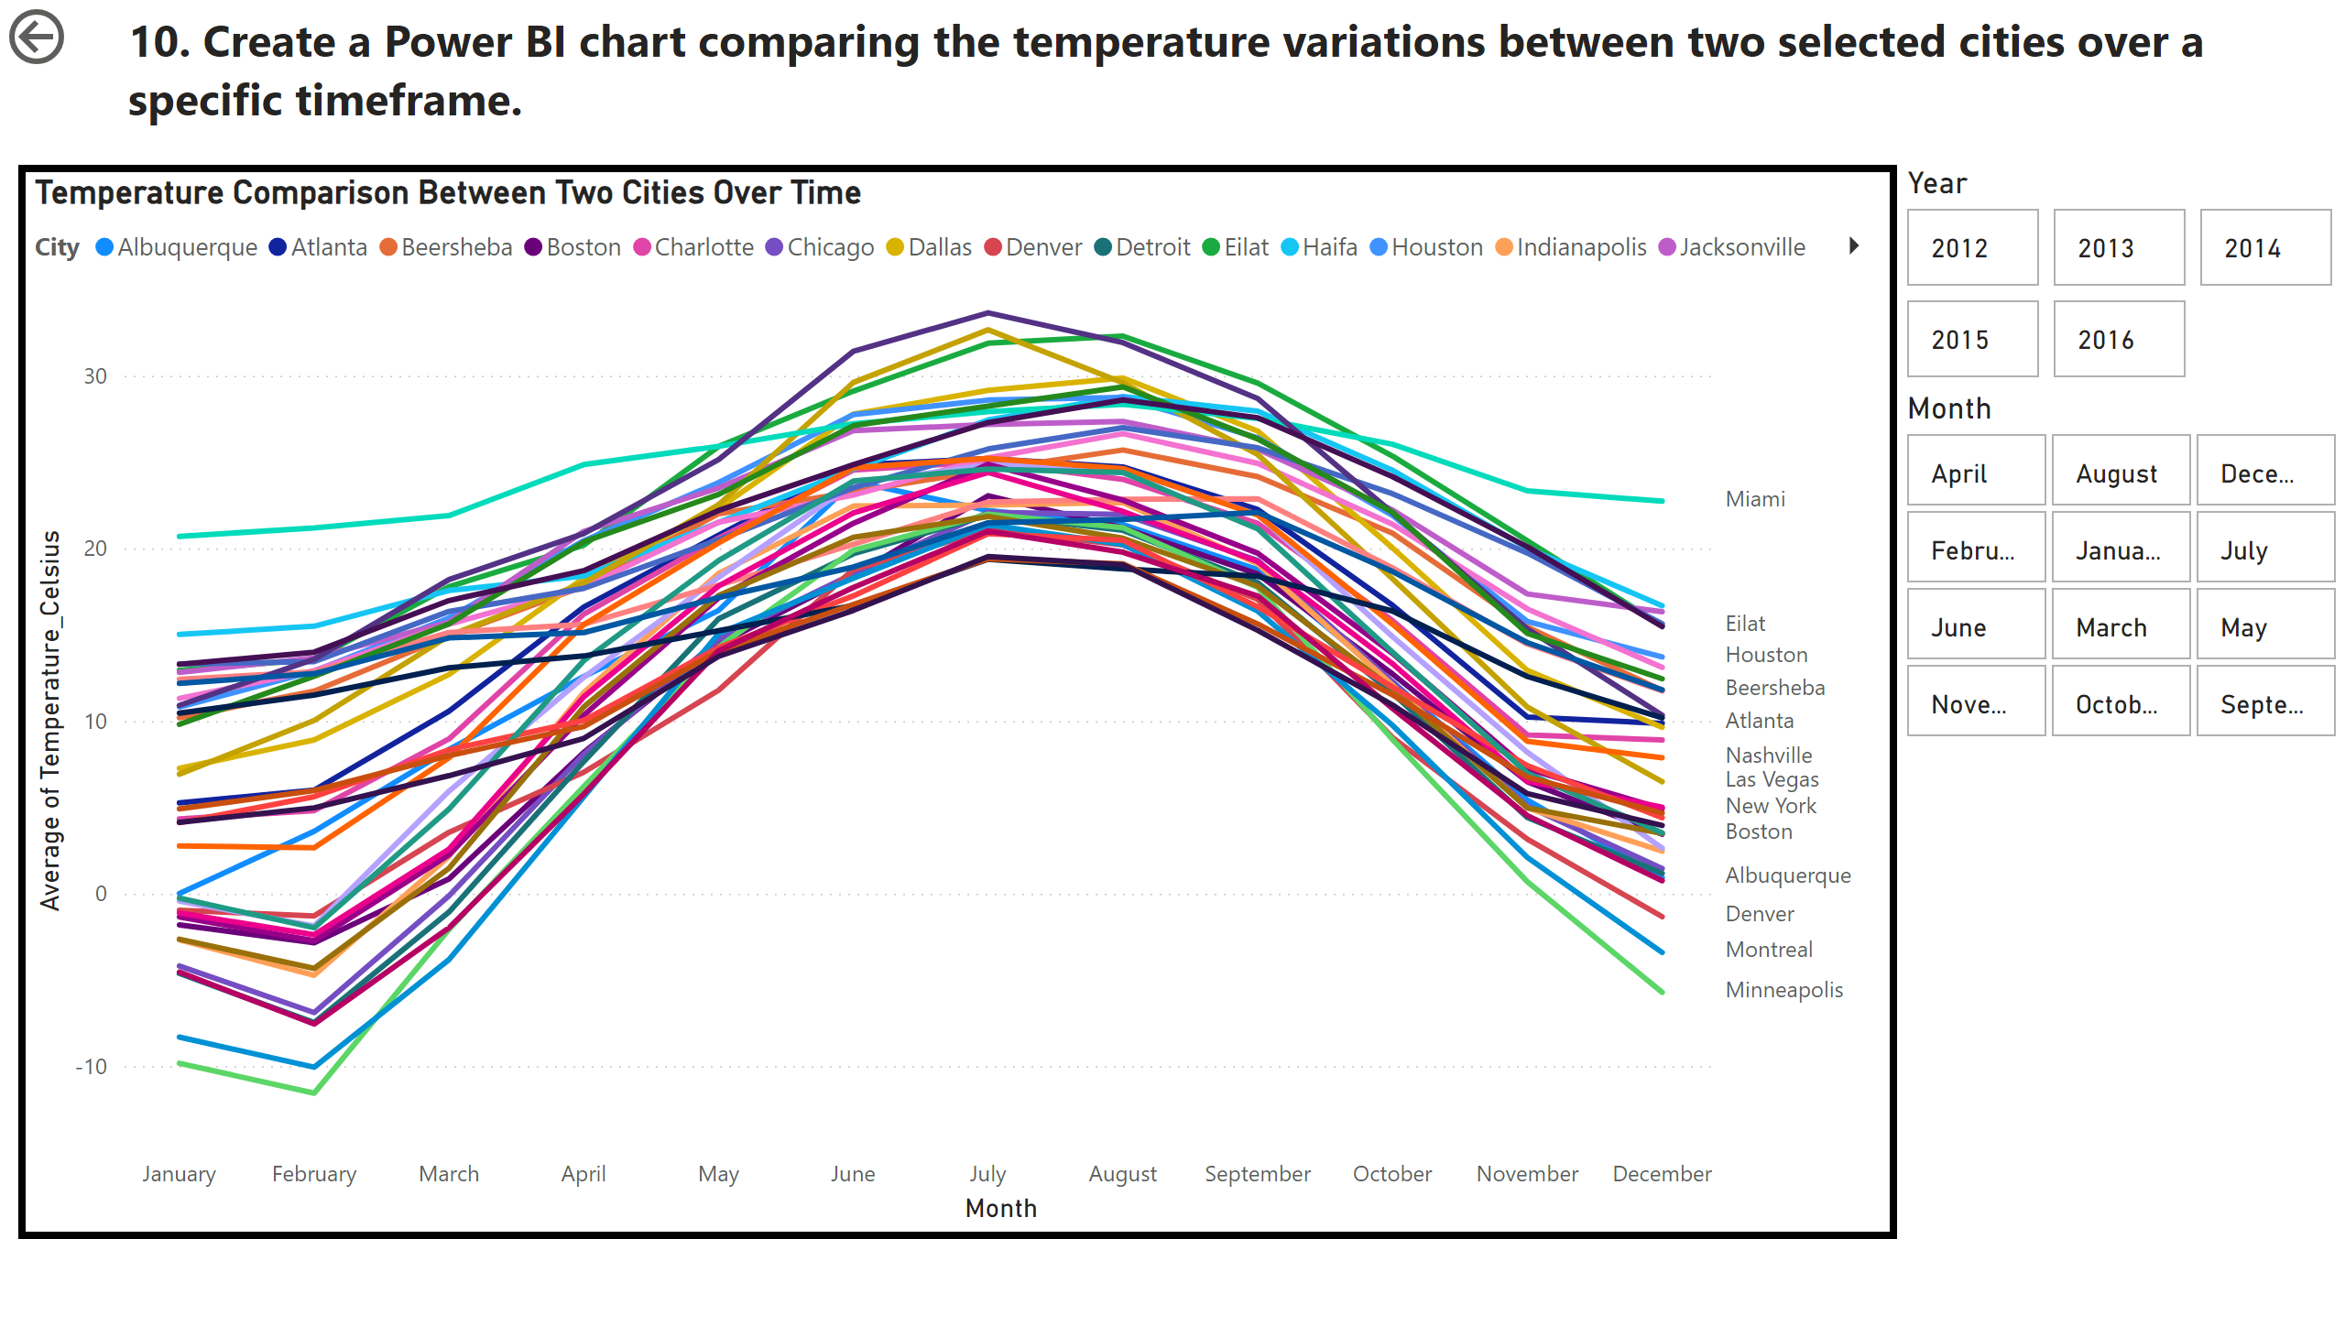
Q10
Notes:
textbox
No alt text provided
Temperature Comparison Between Two Cities Over Time
No alt text provided
slicer
No alt text provided
actionButton
No alt text provided
advancedSlicerVisual
No alt text provided
advancedSlicerVisual
No alt text provided

Slide 16
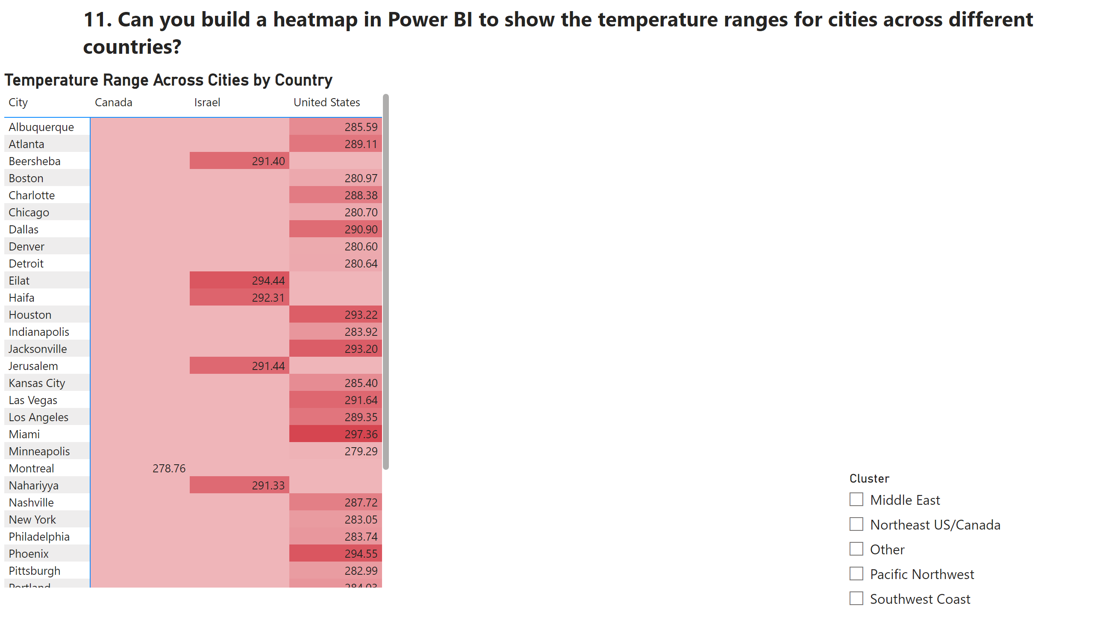
Q11
Notes:
Temperature Range Across Cities by Country
No alt text provided
textbox
No alt text provided
slicer
No alt text provided
slicer
No alt text provided

Slide 17
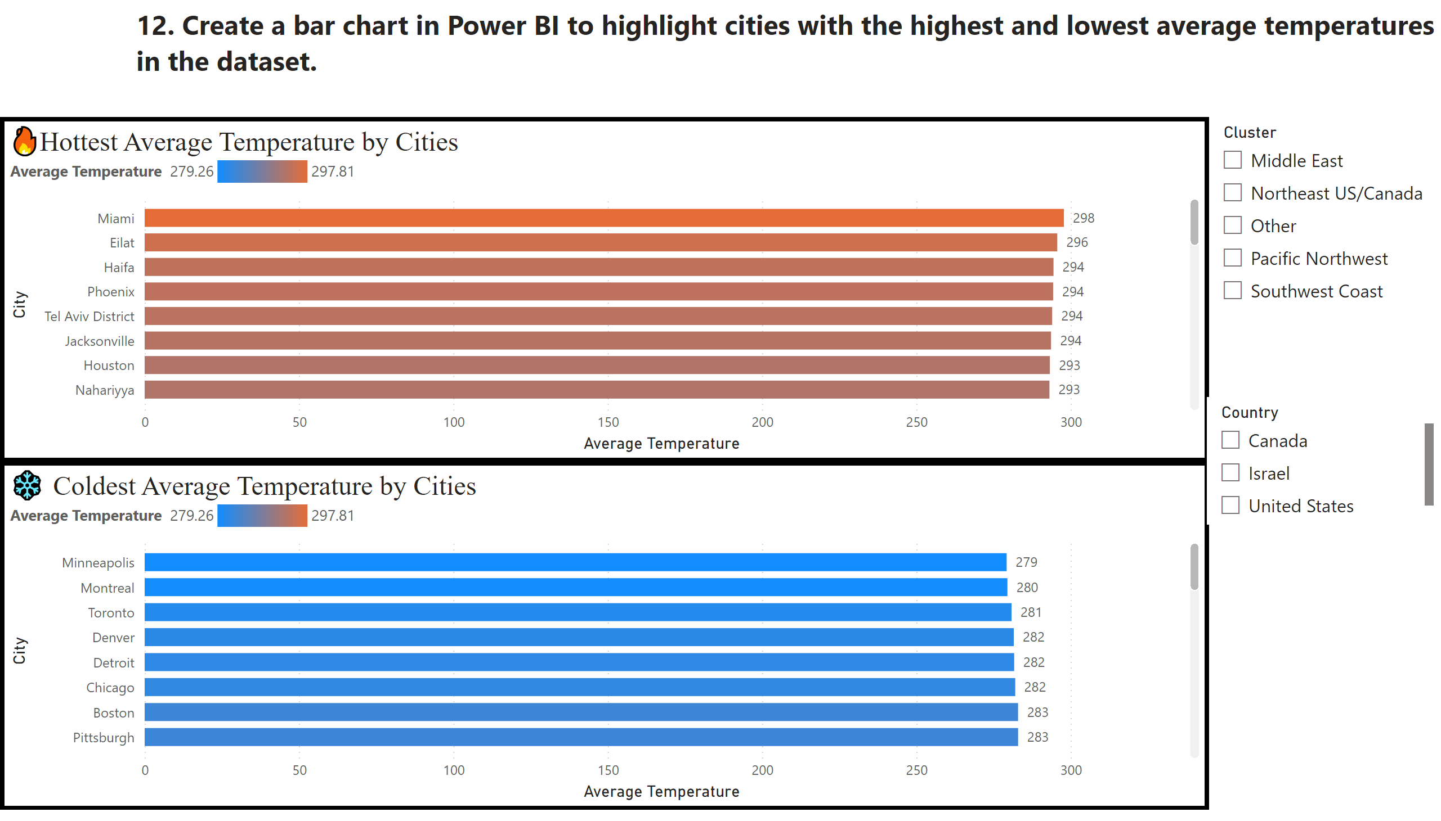
Q12
Notes:
textbox
No alt text provided
🔥Hottest Average Temperature by Cities
No alt text provided
❄️ Coldest Average Temperature by Cities
No alt text provided
slicer
No alt text provided
slicer
No alt text provided
slicer
No alt text provided

Slide 18
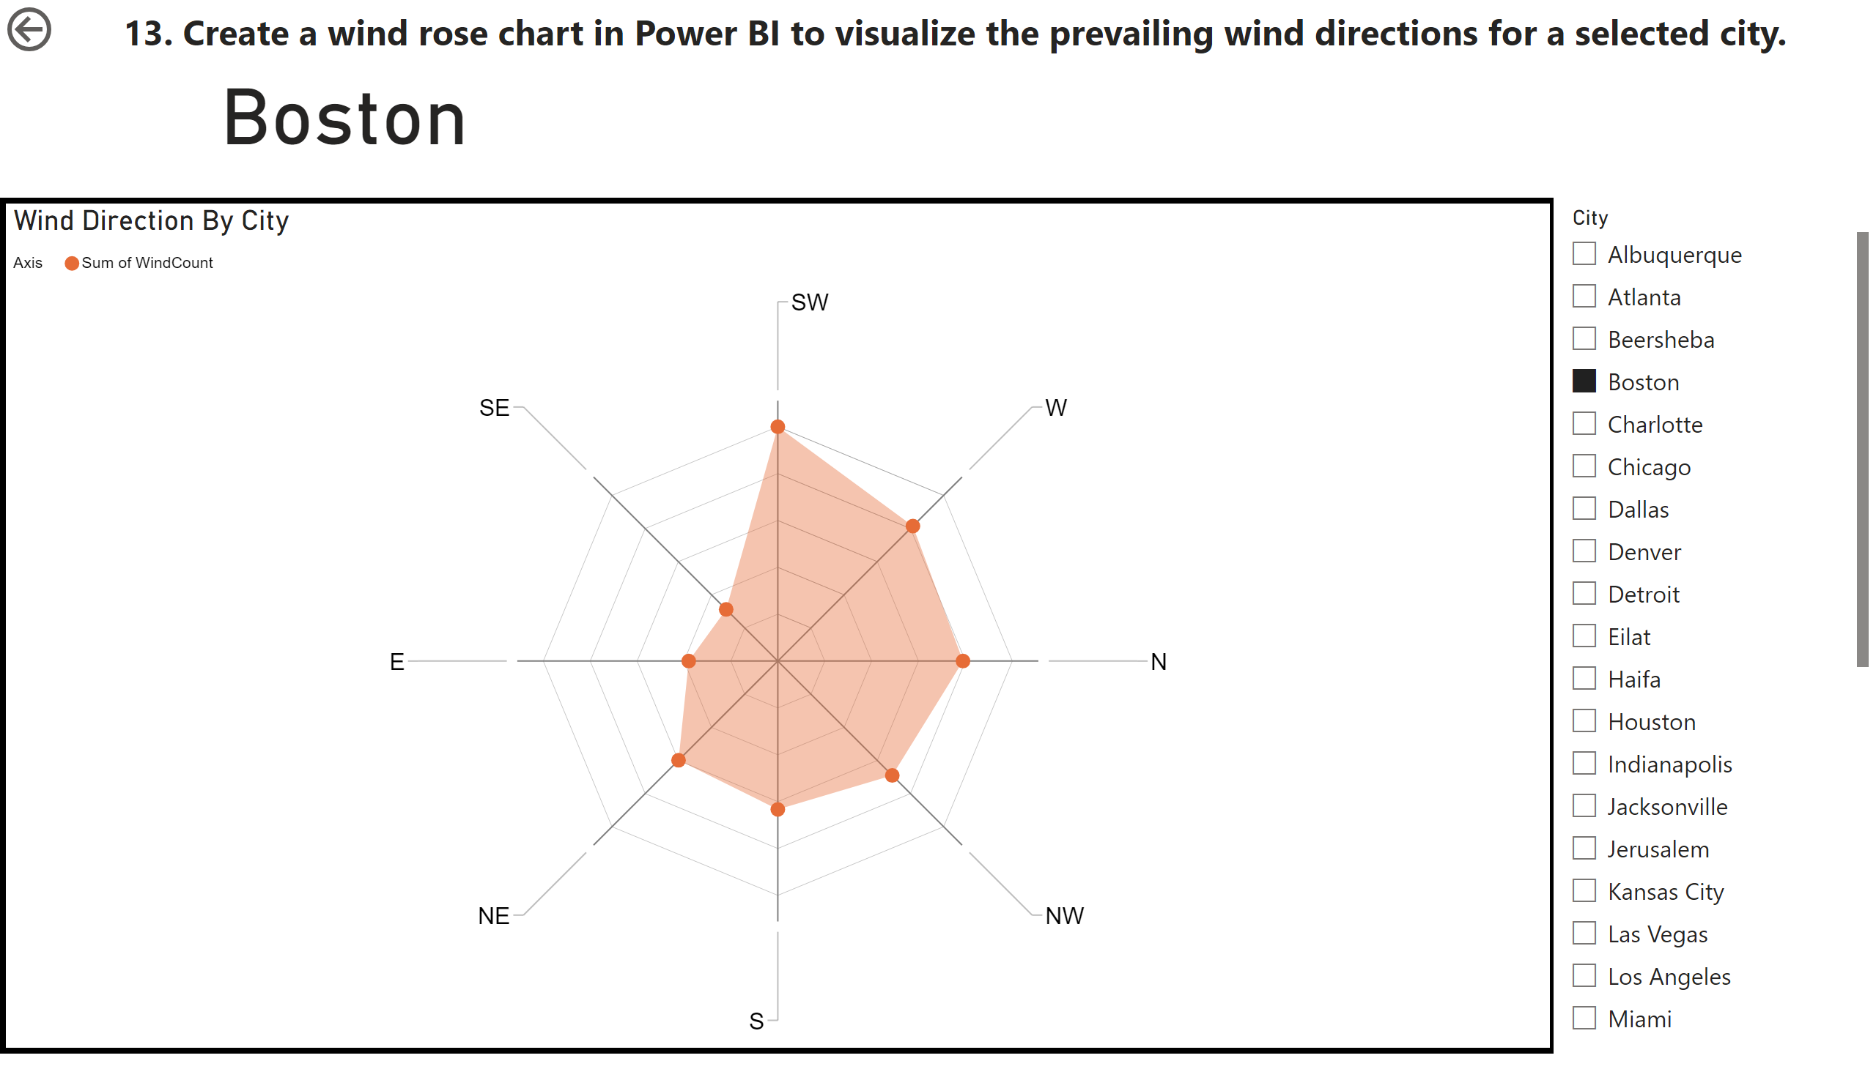
Q13
Notes:
textbox
No alt text provided
Wind Direction By City
No alt text provided
slicer
No alt text provided
actionButton
No alt text provided
card
No alt text provided

Slide 19
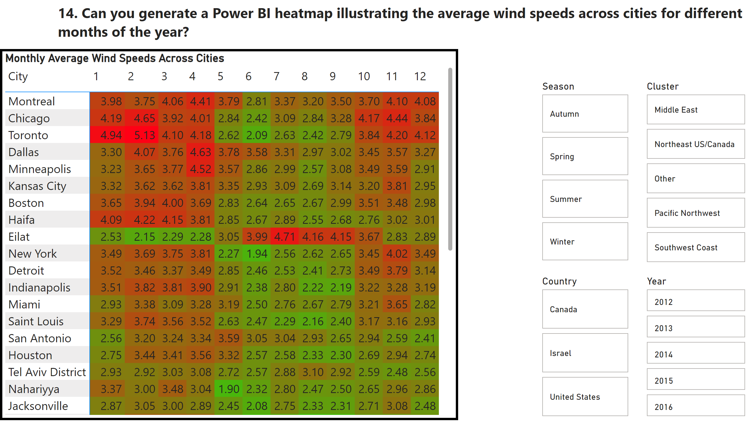
Q14
Notes:
textbox
No alt text provided
Monthly Average Wind Speeds Across Cities
No alt text provided
advancedSlicerVisual
No alt text provided
advancedSlicerVisual
No alt text provided
advancedSlicerVisual
No alt text provided
advancedSlicerVisual
No alt text provided

Slide 20
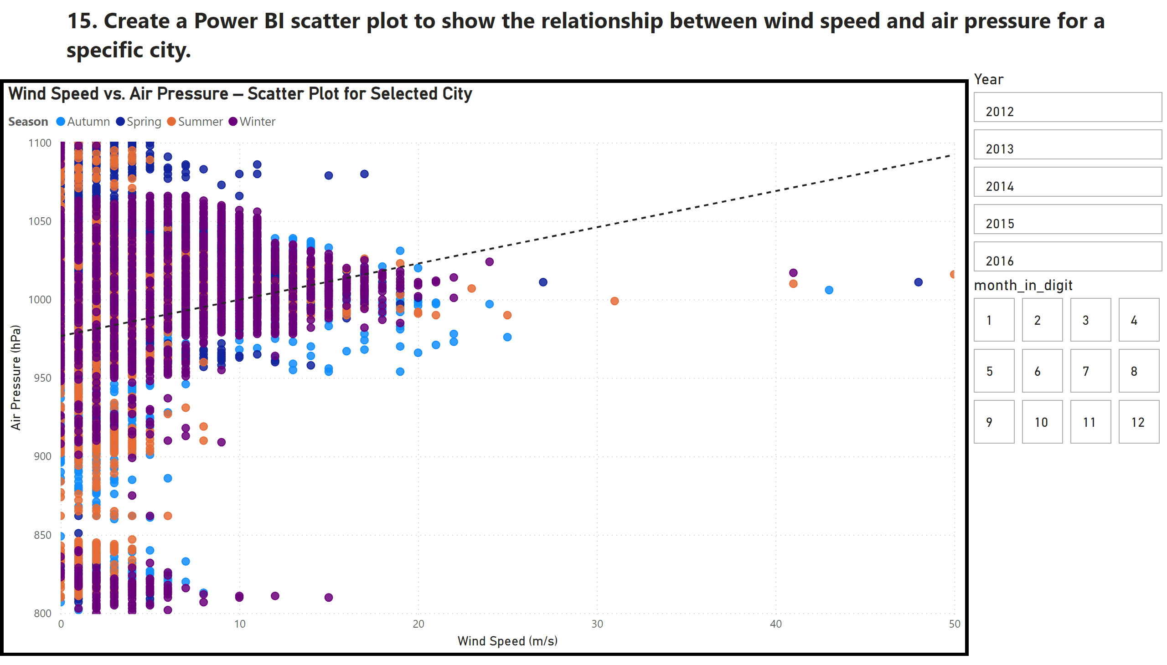
Q15
Notes:
textbox
No alt text provided
Wind Speed vs. Air Pressure – Scatter Plot for Selected City
No alt text provided
slicer
No alt text provided
advancedSlicerVisual
No alt text provided
advancedSlicerVisual
No alt text provided

